Slide 1
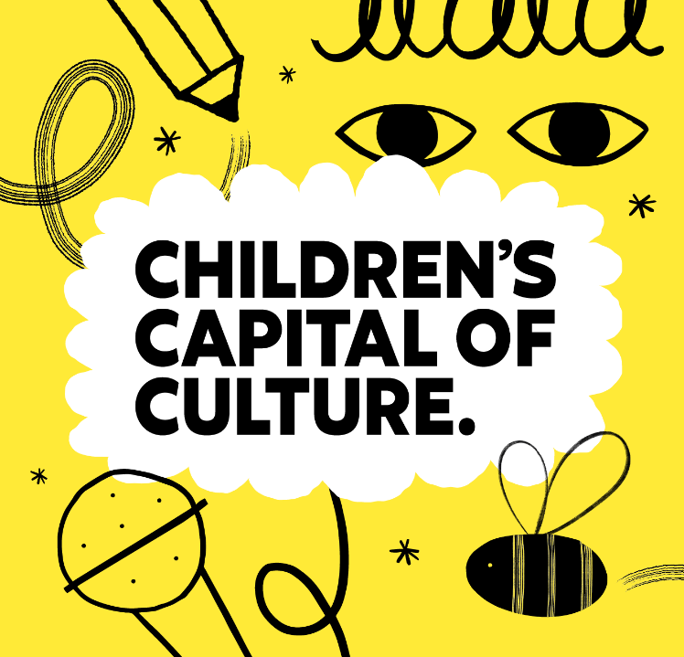

Introducing Children’s Capital of Culture
Notes:
Ask for a show of hands.
Q. Has anyone heard of Children’s Capital of Culture?
Q. Has anyone been to Otherham, Roots or Grimm and Cos Festival of Stories?

Slide 2

What is Children’s Capital of Culture?
Children’s Capital of Culture was an idea proposed by children and young people in Rotherham.
2025 will be a year-long festival of imagination, creativity and community, devised, developed and delivered in partnership with children and young people from Rotherham aged 0-to-25
Notes:
Use the link in the title to show the Children’s Capital of Culture launch film: https://youtu.be/FcKeR5p_0jE?si=ZUmp4em6TMRUZuCq
We really want to emphasise that Children’s Capital of Culture was an idea suggested by children and young people and that children and young people have been involved in the decision-making about the programme of events throughout.

Slide 3

Aims of the Creative Learning Programme:
What difference will it make?
Children and young people feel proud to call Rotherham their home
Children will have more access to the arts, sports and culture.
Children will be creative thinkers and learners who make decisions about things that are important to them.
Children will find out about more creative careers.
Notes:
Q Which of these do you think is the most important and why?

Slide 4
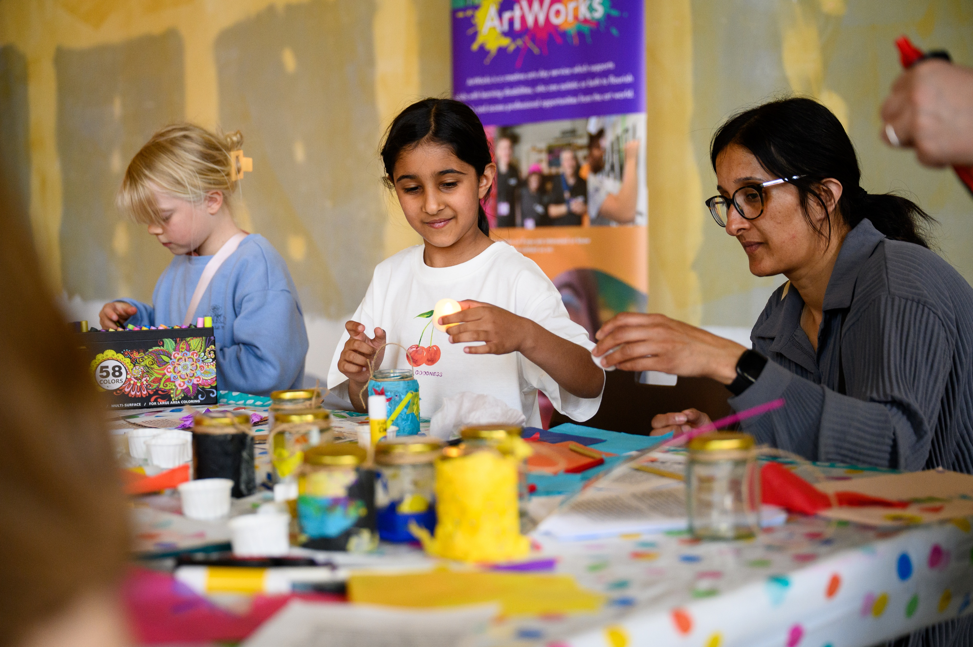

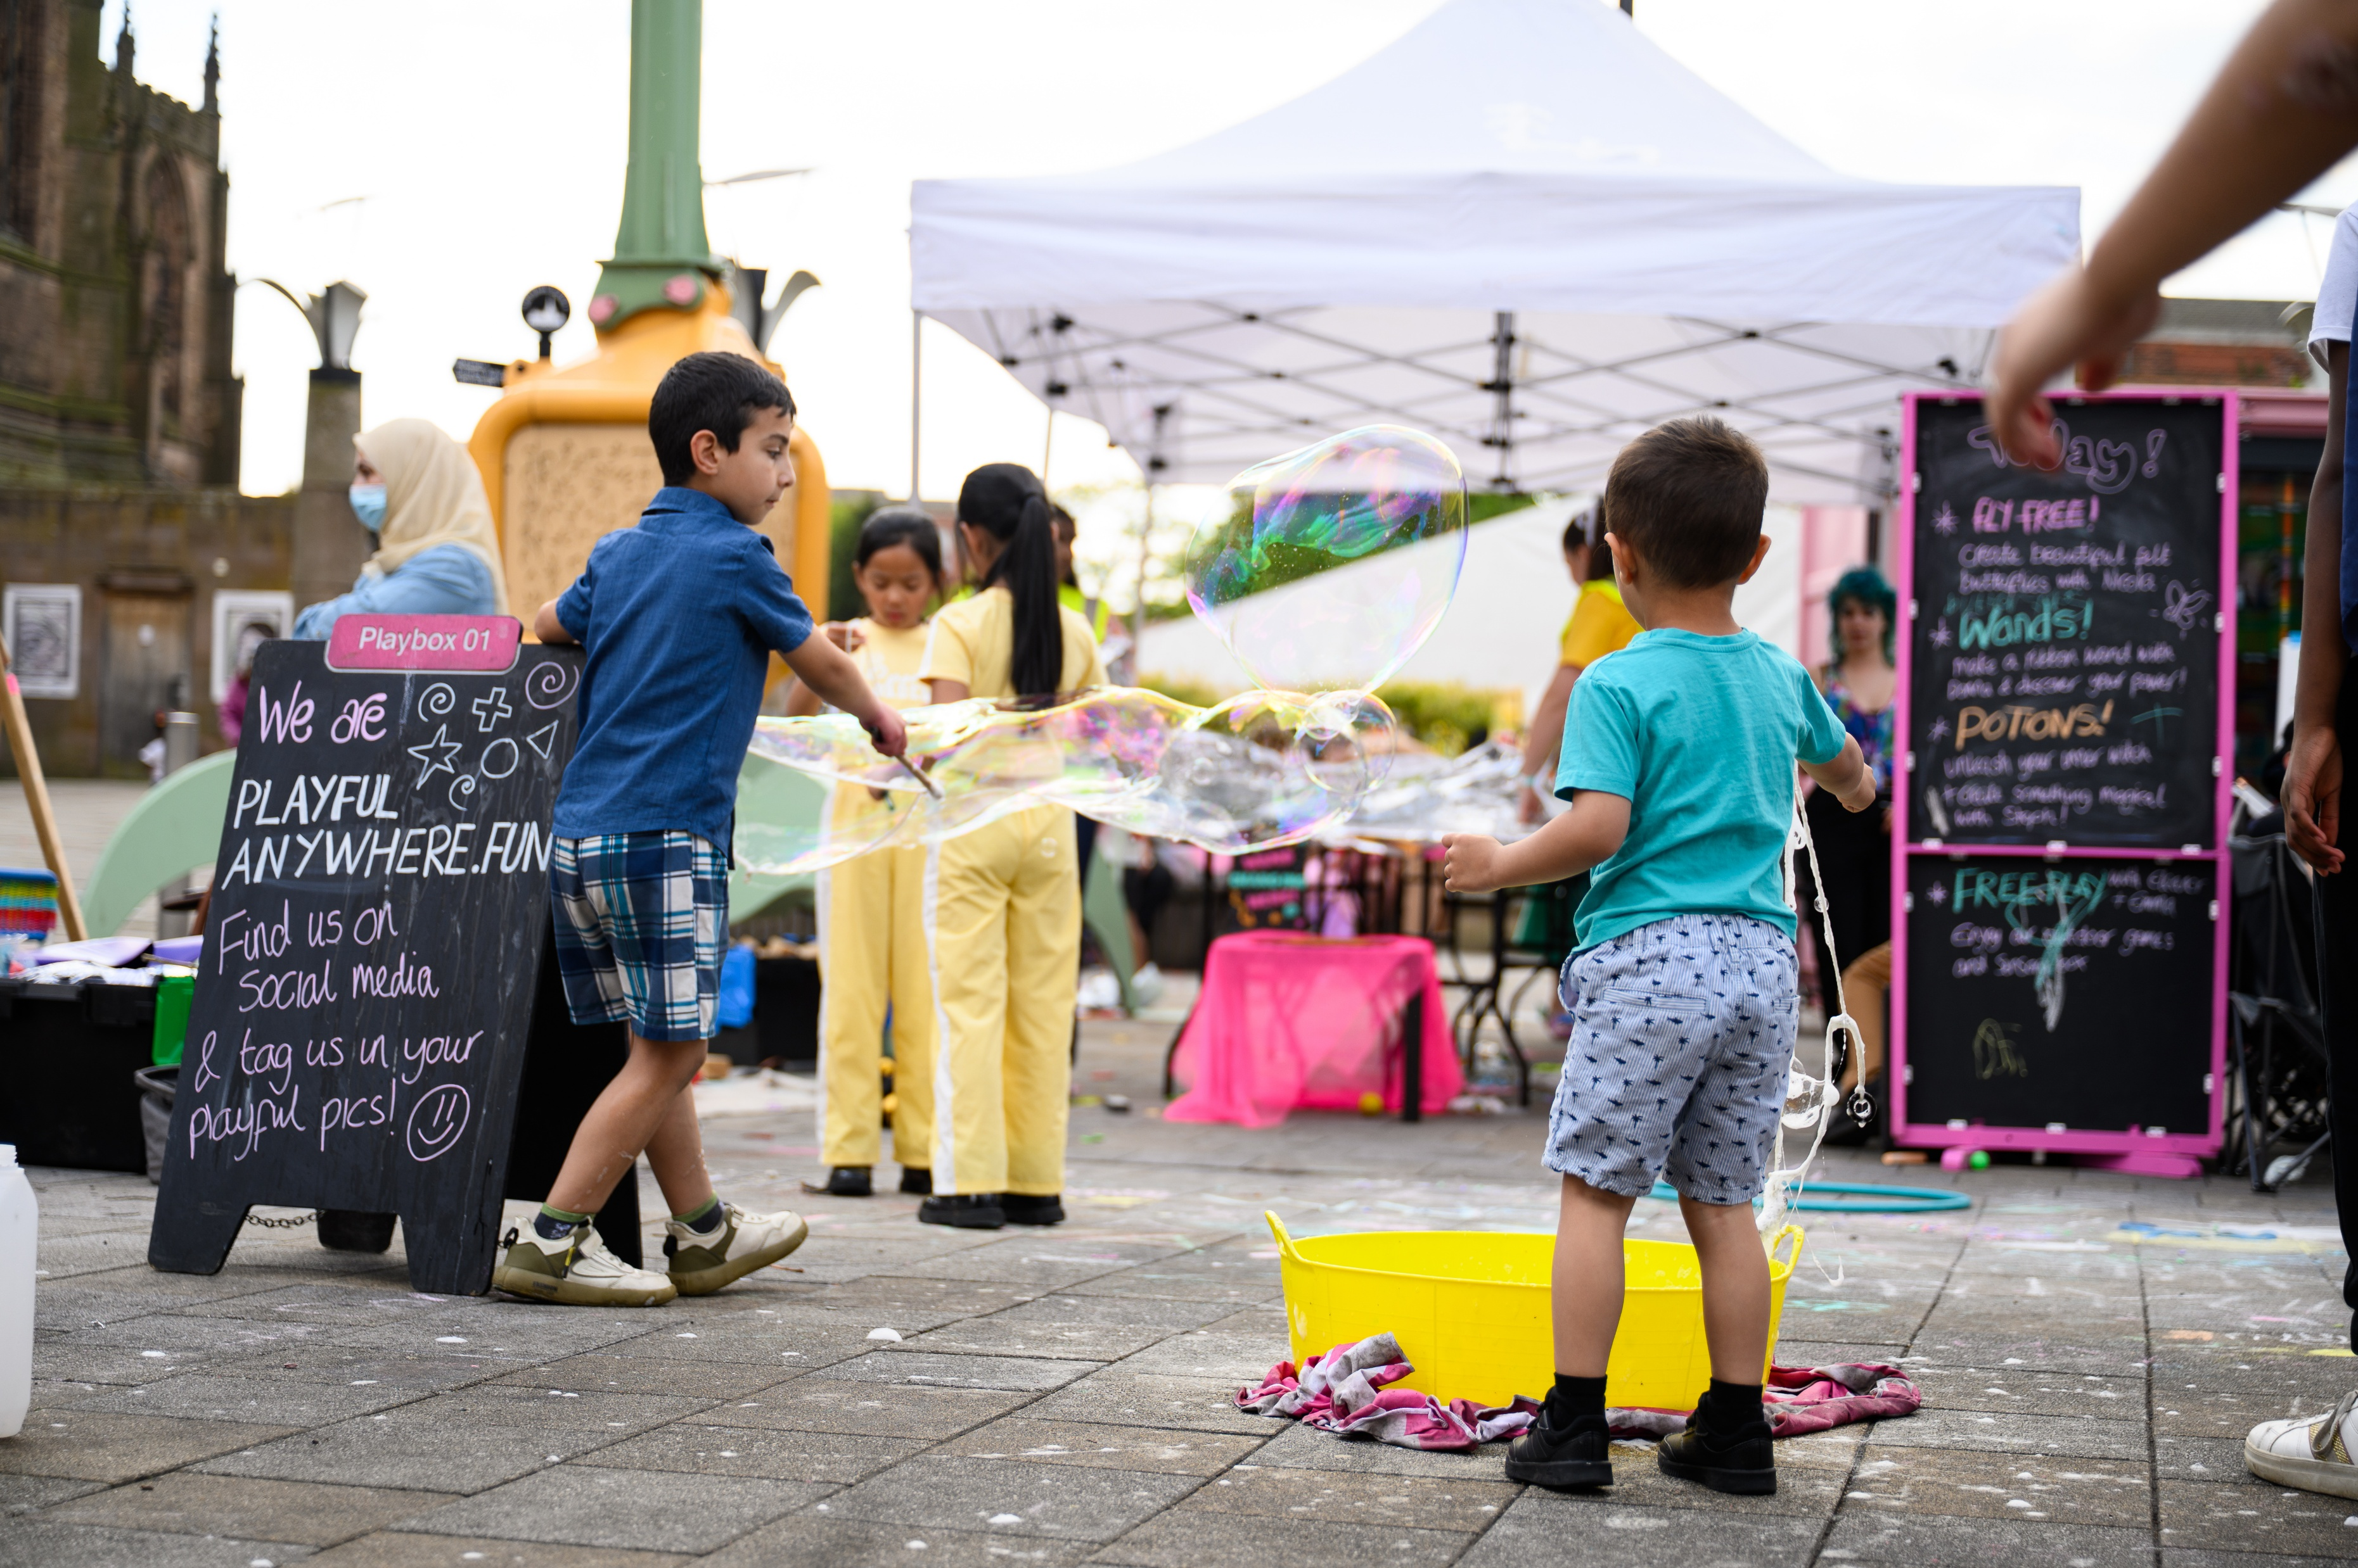
Children’s Capital of Culture Themes
When we asked children and young people about what they would like to change about Rotherham.
Many ideas were suggested, including a new cinema for the town centre.
They also came up with the themes for the events and festivals.
Notes:
We are keen for children and young people to understand that they can have agency and inform decision-making in their borough.

Slide 5


You’re Not From New York City, You’re From Rov’rum
This theme is focused on celebrating the brilliant people, places and stories that already exist in Rotherham. It champions the gems of our borough and helps make people feel proud to call Rotherham home.
Who We Are, Where We Come From
This theme is focused on celebrating the diverse individuals and communities who call Rotherham home. Activity will seek to build community cohesion and champion marginalised and underrepresented groups, increasing equality, accessibility and inclusion.
Notes:
Q Which theme is your favourite?

Slide 6


Plug In & Play
This theme is focused on all sorts of play and games. It covers elite sports, grassroots games and play-based activities – for all ages! It also includes videogaming, coding, and different forms of digital making such filming, photography, projection mapping, AR, VR – and much more!
World Beneath Our Feet
This theme is focused on celebrating our borough’s natural environments. It has a focus on sustainability and conservation, helping make sure Rotherham’s woodlands, meadows, parks, rivers and lakes can be enjoyed by generations to come.
Notes:
Which theme do you think is most important?

Slide 7
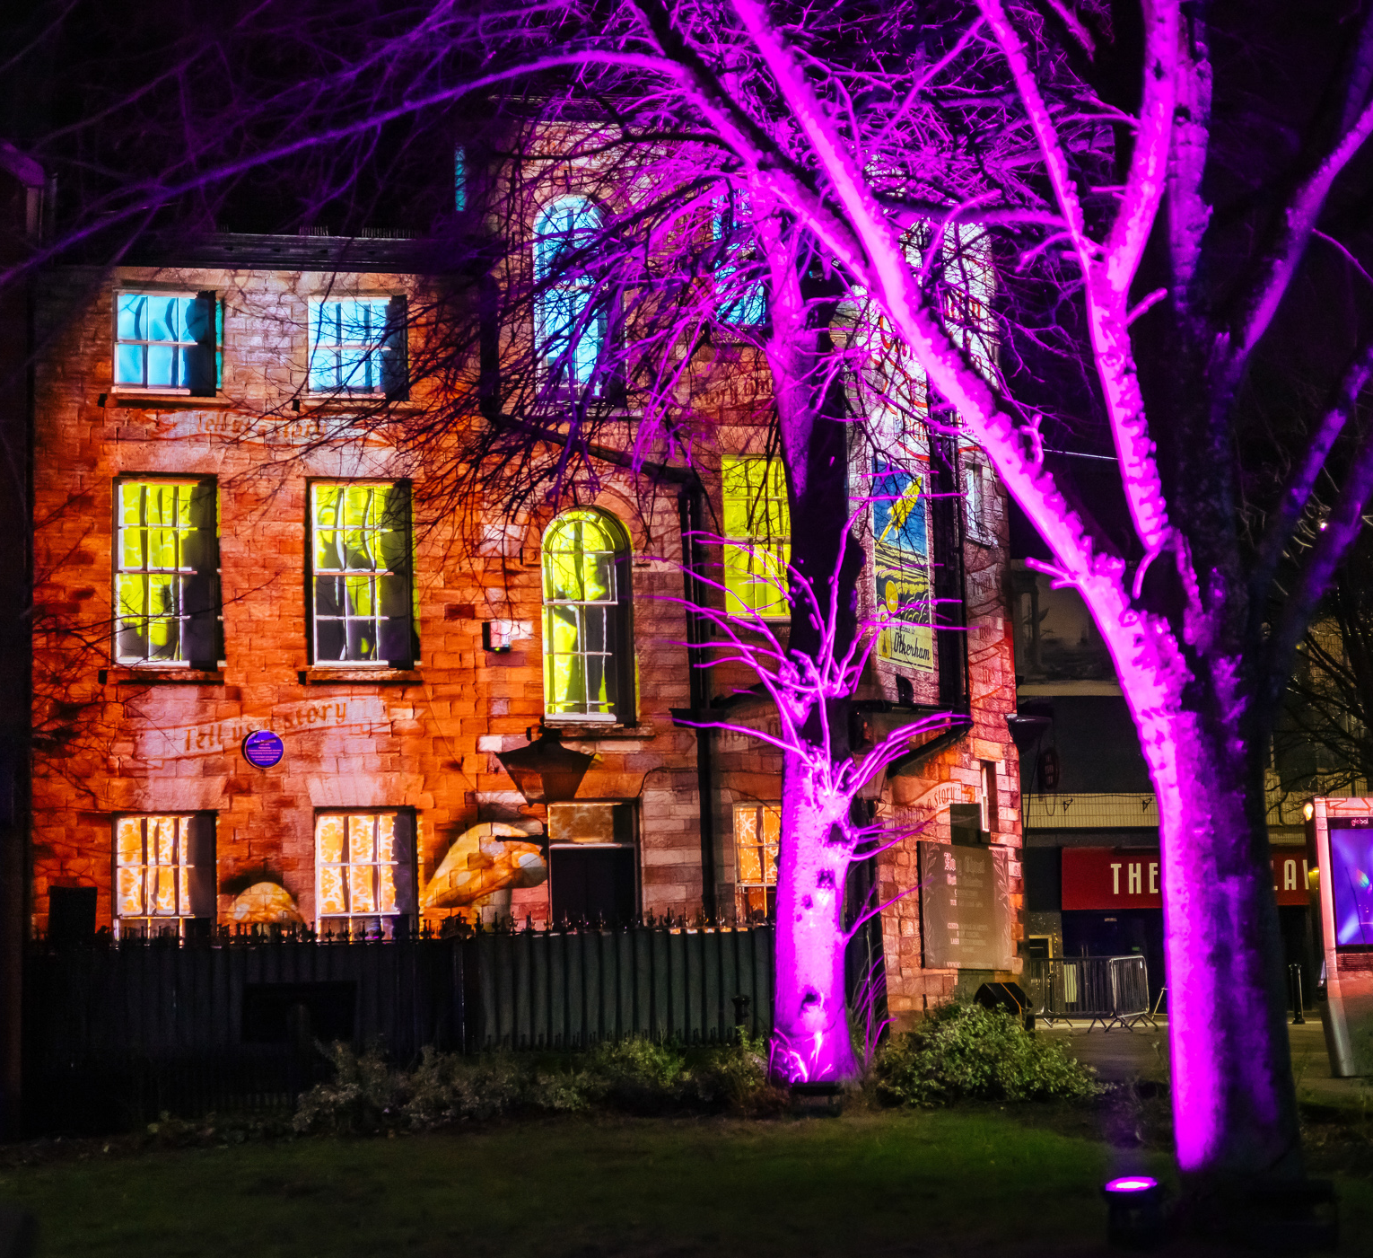
Children’s Capital of Culture has invited children and young people to share their ideas for new events, projects, places and activities for Rotherham.
Notes:
Q. What activity or event would you propose for your school, library, community or town?

Slide 8
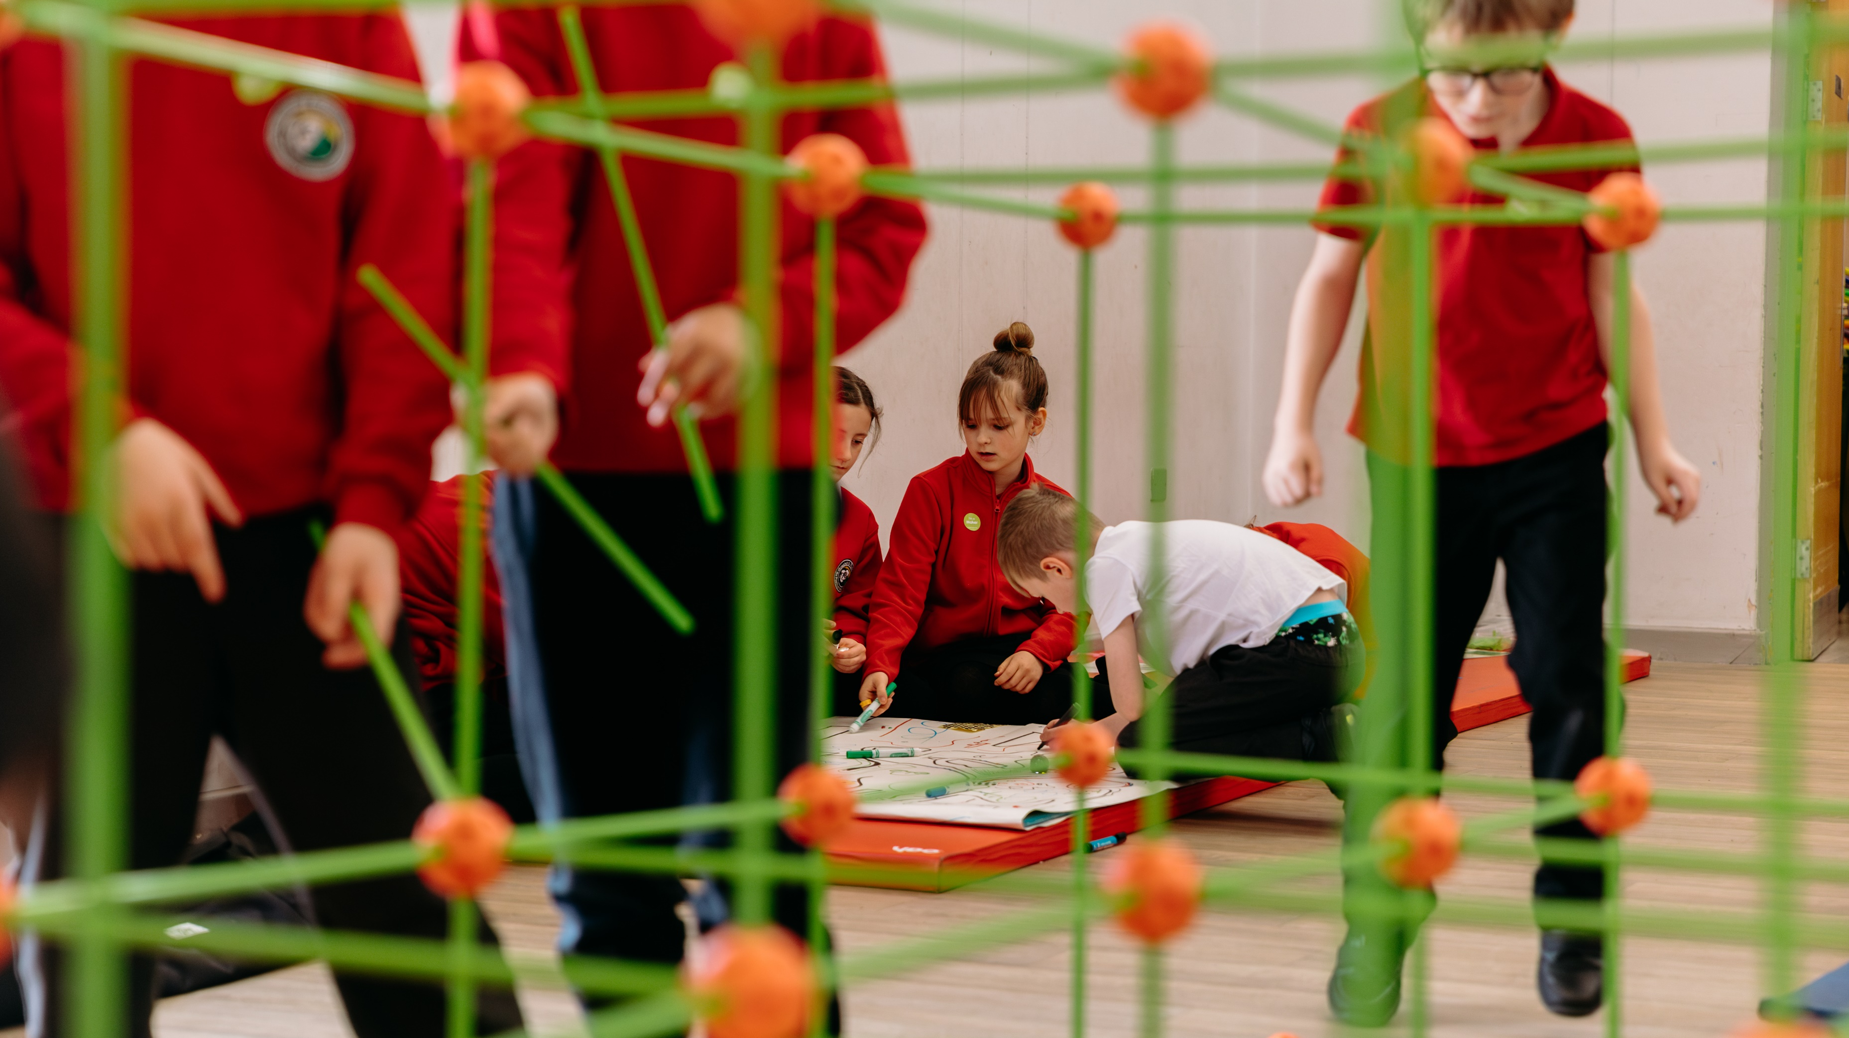
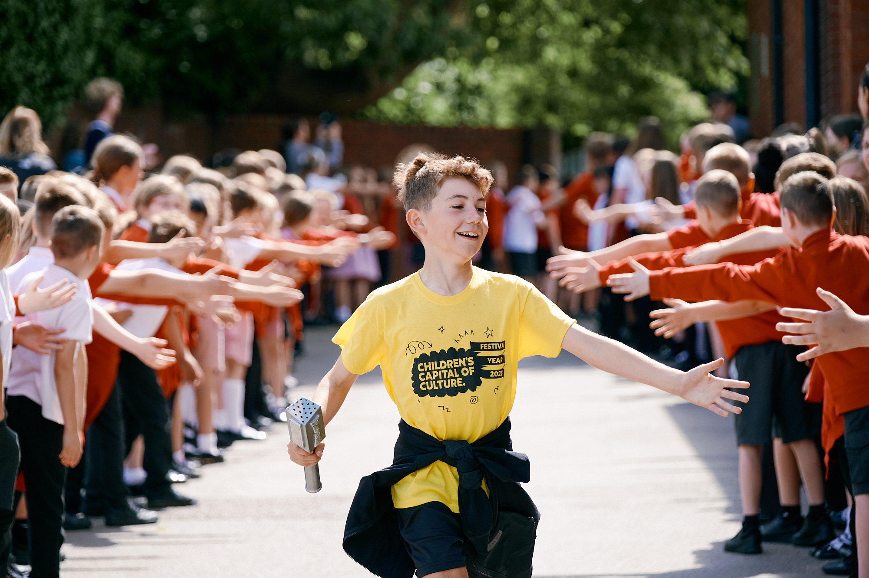
At our school we are participating in ReMake and the Baton Relay….
Notes:
Adapt this slide to tell the children and young people which Children’s Capital of Culture projects you have been involved in.
Creative Learning – Children's Capital of Culture
Tell them that there are lots more activities for schools to get involved in, including a film and media festival called RePlay in November.

Slide 9
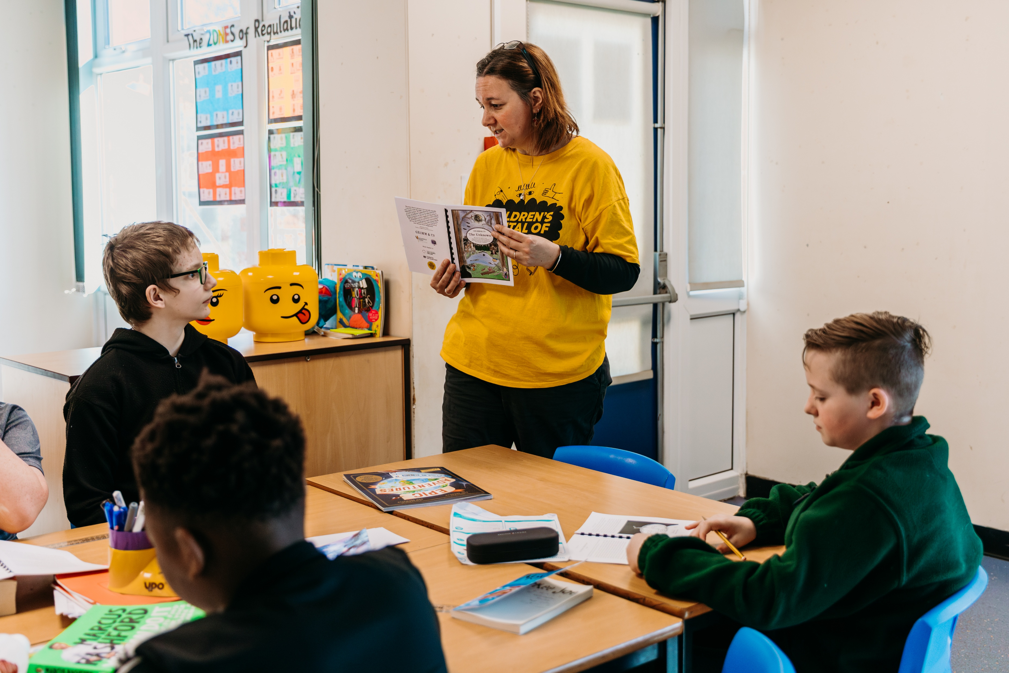
Children’s Capital of Culture Loves Reading
We are inviting every school in Rotherham to create a Children’s Capital of Culture display in your library.
The aim of the task is to create a space which tells your school about Children’s Capital of Culture.
The display should also encourage reading.
Notes:
You could ask for volunteers to do this task, give the job to a class or existing group or work with your school council. We have included some inspiration from Rotherham libraries to give you some ideas.
Remember you also have some Children’s Capital of Culture materials in school you can display (they should have arrived by post).

Slide 10
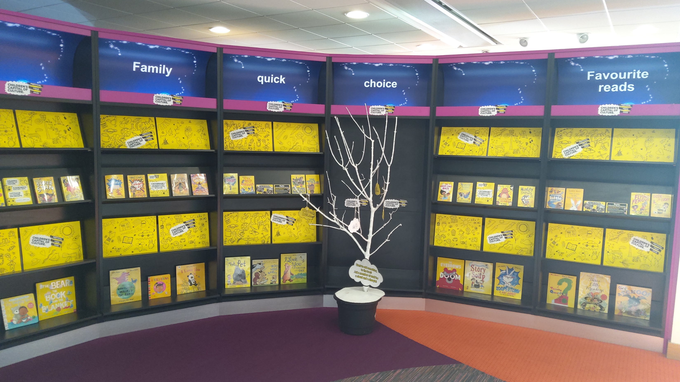
Library display
Notes:
At Riverside library staff used yellow paper and doodles to create a lively display and chose yellow books to link with Children’s Capital of Culture colours (chosen by children).

Slide 11
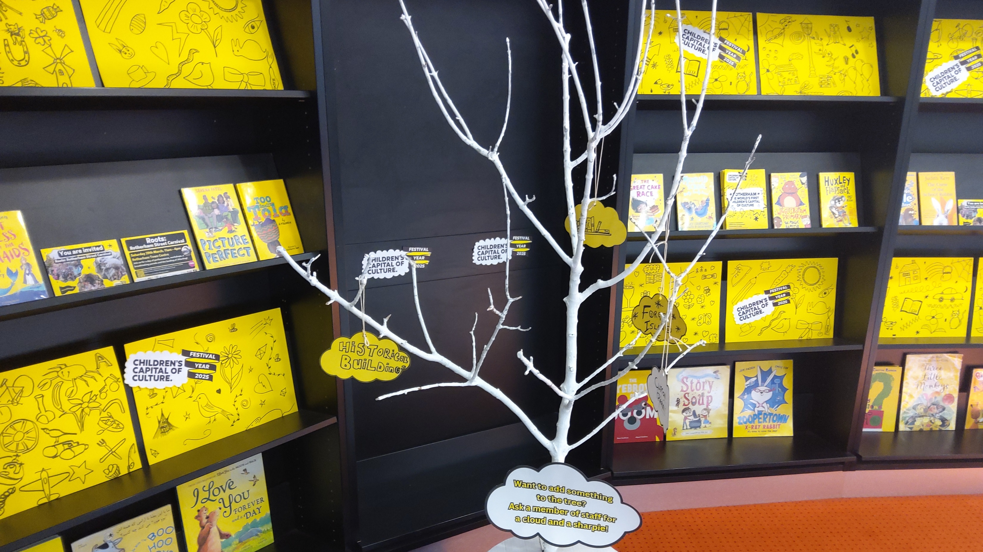
library display
Notes:
At Riverside staff also used a tree to encourage children to suggest their ideas on bright yellow clouds.

Slide 12
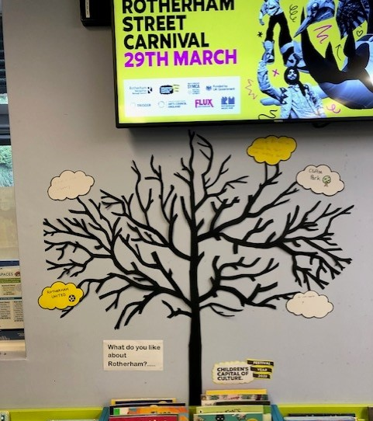
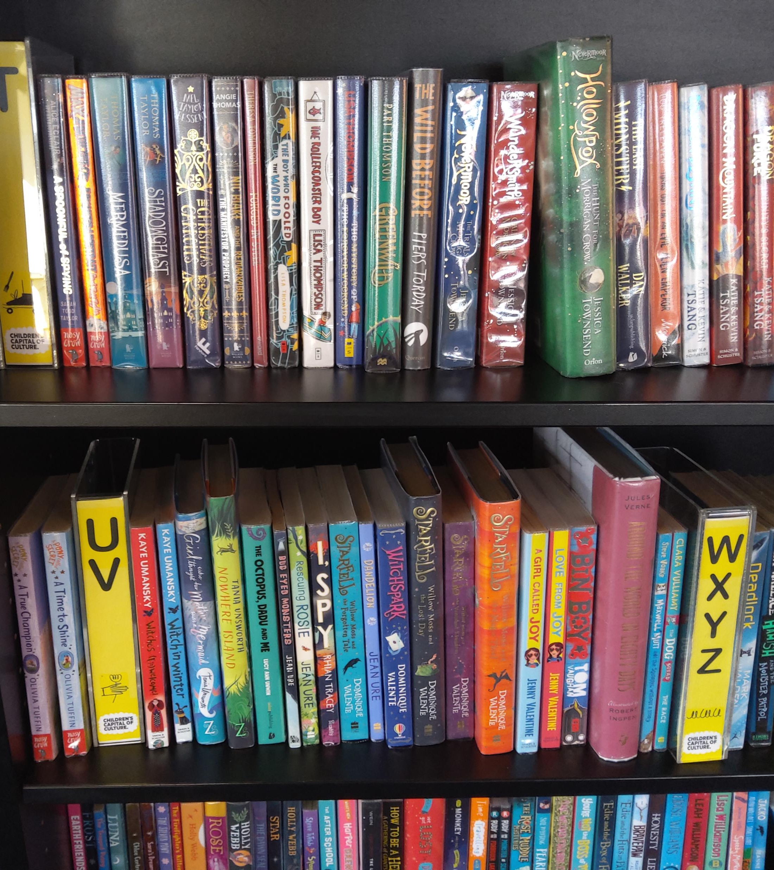
Library display
Notes:
Kimberworth Library also used a tree for children to share their ideas and a screen promotes each new Children’s Capital of Culture event.
You could choose a set of books which match each of the Children’s Capital of Culture themes.

Slide 13
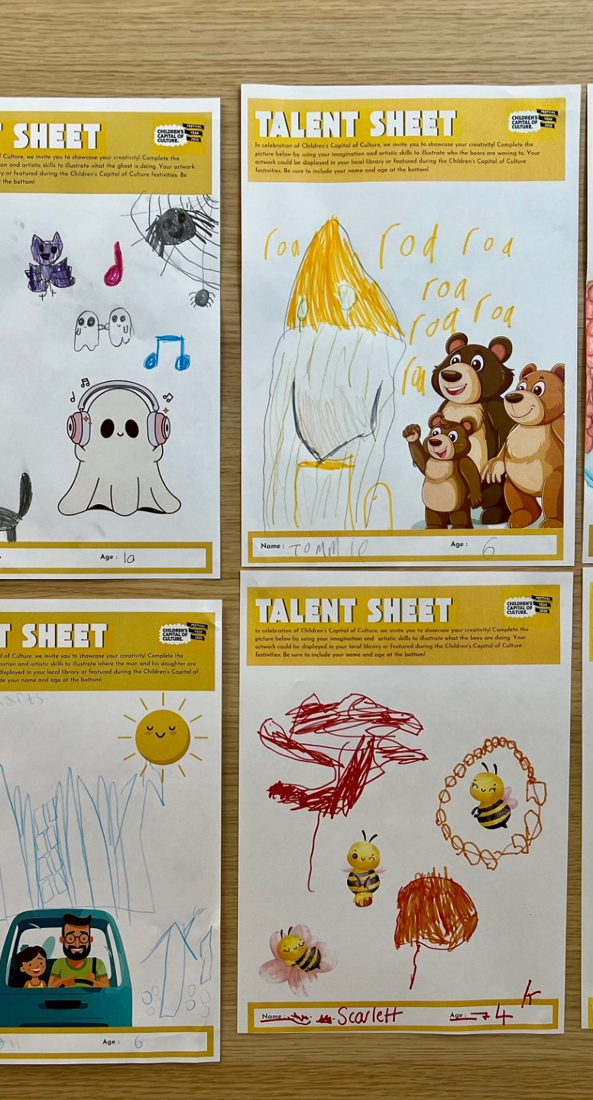
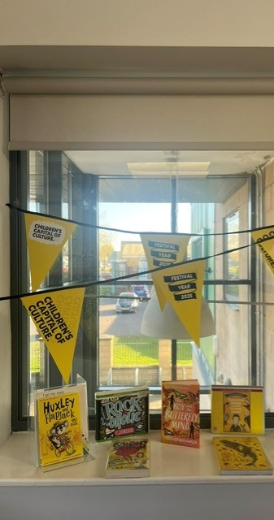
We are very excited to see your library displays.
You can use our planning sheet to help you get started.
Once you have created your display, please share pictures of it with us on social media or by email.
Notes:
At Swinton Library staff create Talent Sheets so that children can share what they are good at and what they are interested in.
Wickersley used a sunny window, some bunting and children’s favourite books.

Slide 14
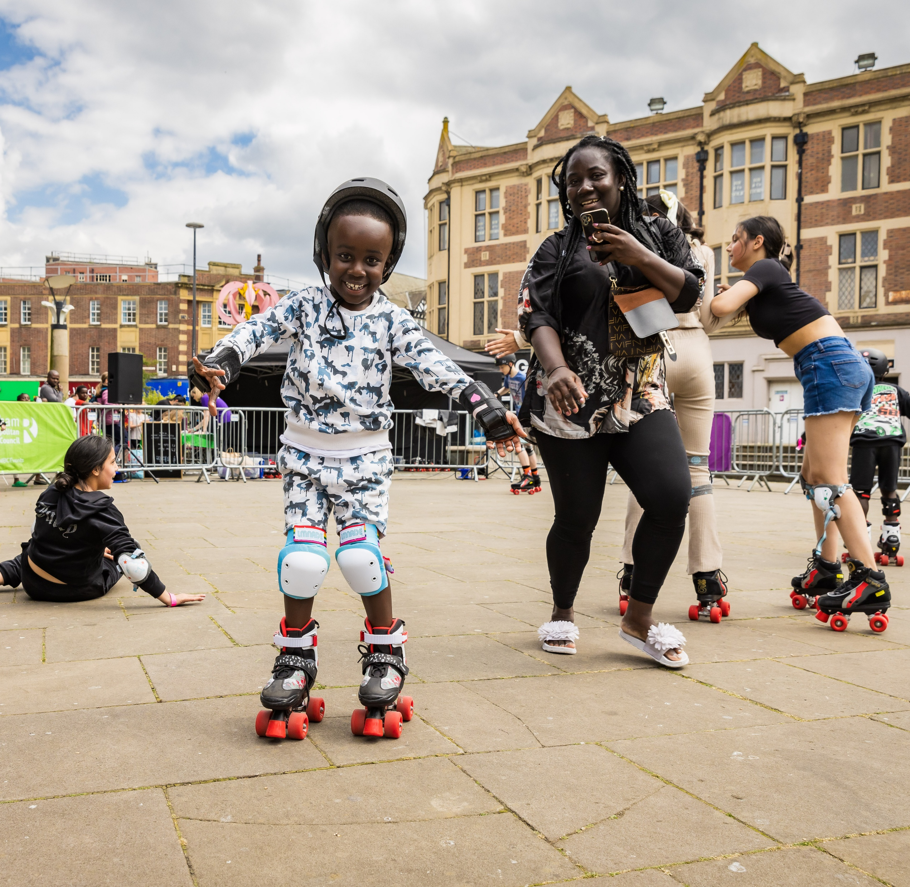

COMING UP….
UPLIFT SPORT FESTIVAL
31ST JULY – 2ND AUGUST
ROTHERHAM SHOW
6th and 7th SEPT
REPLAY FILM AND MEDIA FESTIVAL
10th – 15th NOV
Notes:
SC

Slide 15
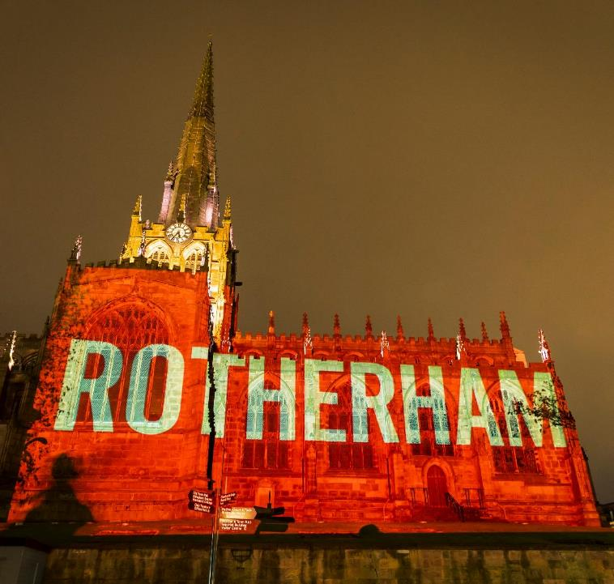

Get in touch:
Dr Becky Parry
Creative Learning Manager
Becky.parry@rotherham.gov.uk
Sarah Christie
CCoC Programme Manager
ccoc@rotherham.gov.uk
Notes:
BP

